Slide 1

Introduction to LaTeX
A Typesetting System for Research and Publications
Dated: 23 Aug 2025
Instructor : Fawad Bahadur
Github: bahadurCorvit

Slide 2
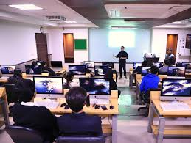






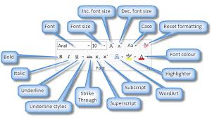
What is LaTeX?
A document preparation system widely used in academia.
Based on TeX, created by Donald Knuth.
Ideal for scientific writing, research papers, thesis, and books.
Handles mathematics, references, and formatting with ease.
Produces professional-quality documents.

Slide 3


Why Use LaTeX?
Professional quality typesetting.
Handles mathematics beautifully (equations, symbols).
Automated referencing (bibliography, citations, cross-references).
Consistent formatting across large documents.
Widely used in academia → journals, conferences, theses.
Free & Open Source (runs on all platforms).

Slide 4
LaTeX vs MS Word
Feature | MS Word 📝 | LaTeX 📄
Formatting | Manual | Automatic & consistent
Equations | Basic support | Advanced, professional
References | Limited | Automated with BibTeX
Large documents | Hard to manage | Easy & structured
Output Quality | Varies | High-quality, publisher standard

Slide 5
First LaTeX Document
Content (Minimal Example):
\documentclass{article}
\begin{document}
Hello World! This is my first LaTeX document.
\end{document}
Explanation:
\documentclass{article} → Defines type of document.
\begin{document} ... \end{document} → Main content goes here.
Compile to get a PDF output.

Slide 6
Document Structure
\documentclass{article}
\title{My First Paper}
\author{Your Name}
\date{\today}
\begin{document}
\maketitle % Generates title
\section{Introduction}
This is the introduction.
\subsection{Background}
Here goes the background.
\section{Conclusion}
This is the conclusion.
\end{document}
Key Points:
\title{} → Document title
\author{} → Author name(s)
\date{} → Can be \today or custom
\section{}, \subsection{} → Structure text

Slide 7
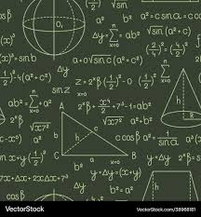
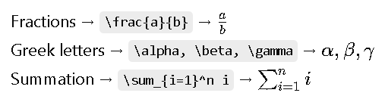
Writing Mathematics
Inline Math:
Written inside $ ... $
Example: Euler's identity: $e^{i\pi} + 1 = 0$
Output: 𝑒^{𝑖𝜋} + 1 = 0
Display Math:
Written inside \[ ... \] or equation environment
\[
a^2 + b^2 = c^2
\]
Symbols:

Slide 8
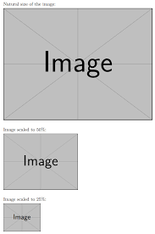
Figures
Insert a Figure:
\begin{figure}[h]
\centering
\includegraphics[width=0.5\textwidth]{image.png}
\caption{An example figure}
\label{fig:sample}
\end{figure}
\includegraphics{} → Insert image (needs graphicx package)
\caption{} → Adds caption
\label{} → Reference figure in text

Slide 9
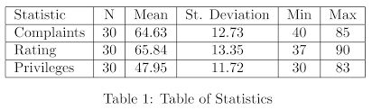
Tables
Insert a Table:
\begin{table}[h]
\centering
\begin{tabular}{|c|c|}
\hline
A & B \\ \hline
1 & 2 \\ \hline
\end{tabular}
\caption{Simple Table}
\label{tab:sample}
\end{table}

Slide 10
References and Citations
Step 1: Create a .bib file (e.g., references.bib)
@article{einstein1905,
author = {Albert Einstein},
title = {On the Electrodynamics of Moving Bodies},
journal = {Annalen der Physik},
year = {1905}
}
Step 2: Cite in Your Document
Einstein introduced relativity in \cite{einstein1905}.
Step 3: Add Bibliography Section
\bibliographystyle{plain}
\bibliography{references}

Slide 11
Useful LaTeX Packages
Mathematics & Symbols
\usepackage{amsmath, amssymb}
Figures & Graphics
\usepackage{graphicx}
References & Hyperlinks
\usepackage{hyperref}
Better Tables
\usepackage{booktabs}
Page Layout
\usepackage{geometry}

Slide 12
Advanced Features in LaTeX
Cross-References:
As shown in Figure~\ref{fig:sample}, results are significant.
\label{} + \ref{} → Auto numbering
Lists:
\begin{itemize}
\item First point
\item Second point
\end{itemize}
\begin{enumerate}
\item Step one
\item Step two
\end{enumerate}

Slide 13
Tips & Best Practices
Keep each chapter/section in a separate .tex file
Always use version control (Git) for collaborative writing
Learn to use a reference manager (JabRef, Zotero, Mendeley) with BibTeX
Use Overleaf for online editing & collaboration
Comment code with % to stay organized
Use packages only when needed → avoids conflicts
Always compile twice if references don’t appear

Slide 14
Summary & Conclusion
LaTeX is a powerful tool for academic writing.
Produces professional-quality documents (papers, theses, books).
Handles math, references, figures, and large documents with ease.
Widely used in research, publishing, and academia.
Learning LaTeX saves time & ensures consistency.

Slide 15
THANK YOU

